Slide 1
Airline Passenger Satisfaction
Mudit Aggrawal , Jenny Yao , Pedro Jose Trujillo Mejia​, Liliana Tretyakova, ​ Hong-Fei Jin , Himanshu Mayank ​, Nilanjana Raghu ​, Ylfa Liang

Slide 2
Our Team
Mudit Aggarwal – Muditmoody
Hong Fei Jin – jinh1004
Ying-Fang Liang – yingfangliang
Himanshu Mayank – hm6650
Nilanjana R Raghu – Nilanjana-Raghu
Liliana Tretyakova – uliana-tr
Pedro Trujillo Mejia – PedroJoseTrujilloMejia
Jenny Yao – Jiaying-Yao

Slide 3
Team Roles
 | Product Manager | Business Analyst | Data Analyst | Data Scientist
Mudit Aggarwal | 0.5 |  |  | 0.5
Hong Fei Jin |  | 0.5 | 0.5
Ying-Fang Liang |  |  |  | 1
Himanshu Mayank |  |  |  | 1
Nilanjana R Raghu |  |  |  | 1
Liliana Tretyakova | 0.5 | 0.5
Pedro Trujillo Mejia |  | 0.5 | 0.5
Jenny Yao |  |  | 1

Slide 4
Introduction
To Our Dataset and
Business Problem

Slide 5

Business Problem
What factors affect customer satisfaction the most in the context of airline passengers?
"Travel companies are still absorbing COVID-19’s financial impact, and investing in CX now may seem too great a burden for many of them.​
But companies that prioritize CX during a downturn stand to outperform their competition for years to come—as McKinsey research on the 2007–09 downturn has shown.​
Indeed, wise investment in CX may be key to the industry’s survival, and flourishing, in a post-pandemic world."

Slide 6

Dataset
23 variables
including Satisfaction, Flight distance, Type of Travel
103,904
Observations from an airline passenger satisfaction survey

Slide 7
Methodology
And Description of Our
Current Model

Slide 8
More about the Data
 | Neutral or dissatisfied | Satisfied
Numbers | 58, 246 | 44, 618
Percentage | 57% | 43%
X_train, X_test, y_train, y_test = train_test_split(X, y, test_size = 0.33, random_state = 5)

Slide 9
Models We Tried
Logistic regression
SVM
Decision tree
Random Forest
And others

Slide 10
Models Comparison
Decision Tree
Logistic Regression
SVM
87%
88%
95%
Accuracy
Accuracy
Accuracy
Random Forest
95%
Classification score

Slide 11
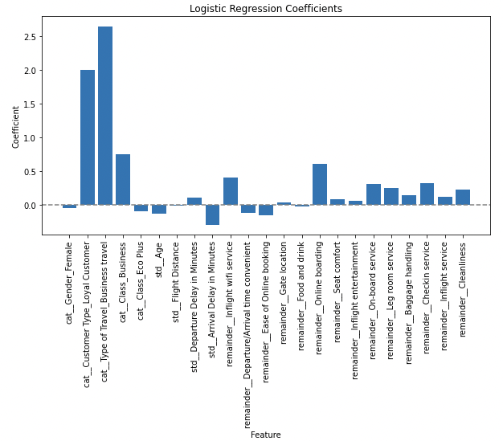
Classification – Logistic Regression

Slide 12
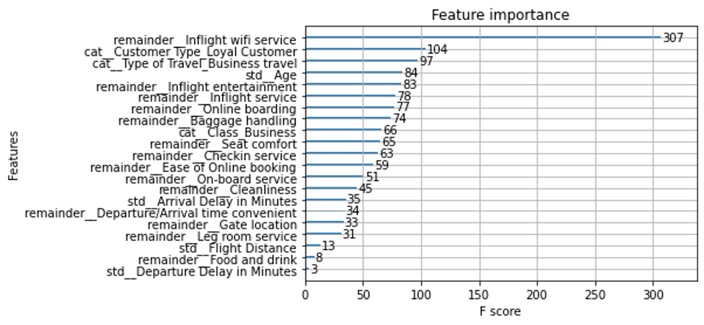
Classification – XGboost

Slide 13
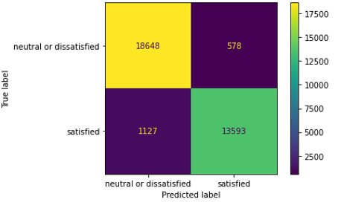
Classification – XGboost
96%
 | Precision | Recall | F1-Score | Support
Neutral or dissatisfied | 0.94 | 0.91 | 0.96 | 19226
Satisfied | 0.96 | 0.84 | 0.94 | 14720
Accuracy |  |  | 0.95 | 33946
Macro avg | 0.95 | 0.95 | 0.95 | 33946
Weighted avg | 0.95 | 0.95 | 0.95 | 33946
Accuracy
Using the best parameters

Slide 14
Takeaways
Our Preliminary Results and Business Insights

Slide 15
Preliminary Results
Treatment I: Inflight Wi-Fi service
 | Business Travel
No | 0.361
YES | 0.174
 | LoYal Customer
No | 0.457
YES | 0.182
 | Flight Distance
Mid-long | o.03
Short | 0.303
CATE

Slide 16
Preliminary Results
Treatment II: Online boarding
 | Age
0-15 | o.027
18-40 | 0.069
41-65 | 0.047
65+ | 0.032
 | Business Travel
No | 0.008
YES | 0.077
 | LoYal Customer
No | 0.019
YES | 0.064
CATE

Slide 17

Business Insights
Wi-Fi Importance
Loyalty Customers
Preference
Age-specific strategies
Customers on short-distance flights or personal travel customers value Wi-Fi quality
These customers value a positive online boarding experience more than quality of in-flight Wi-Fi
Customers of different age groups are looking for different experiences

Slide 18
What next?
Develop a progressive scale to assess customer satisfaction

Slide 19
Thank you!
Any questions?

Slide 20
Project Links
Git Project - https://github.com/orgs/McGill-MMA-EnterpriseAnalytics/projects/29
Git Repository - https://github.com/McGill-MMA-EnterpriseAnalytics/Flyer_Customer_Satisfaction

Slide 21
Appendix

Slide 22
Preprocessing
& Exploratory data analysis (EDA)

Slide 23
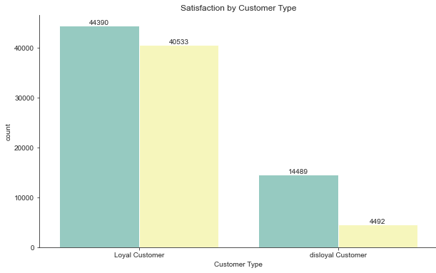
Exploration of the Data
Disloyal customers did not provide much feedback unfortunately The significantly higher rate of dissatisfied disloyal customers may be partially caused from the lack of additional services loyal members may receive (data leakage)

Slide 24
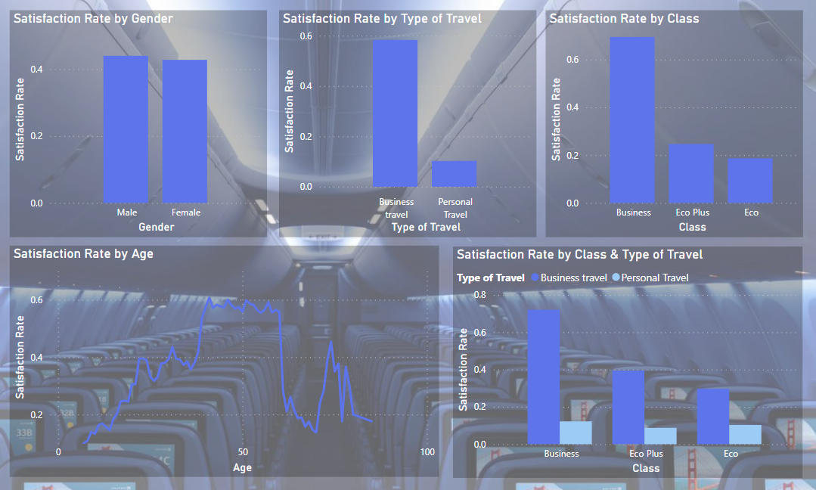
Exploration of the Data
We also note the high satisfaction rate for business travelers and those sitting in business class, which is unsurprising if we consider that such passengers typically receive better service

Slide 25
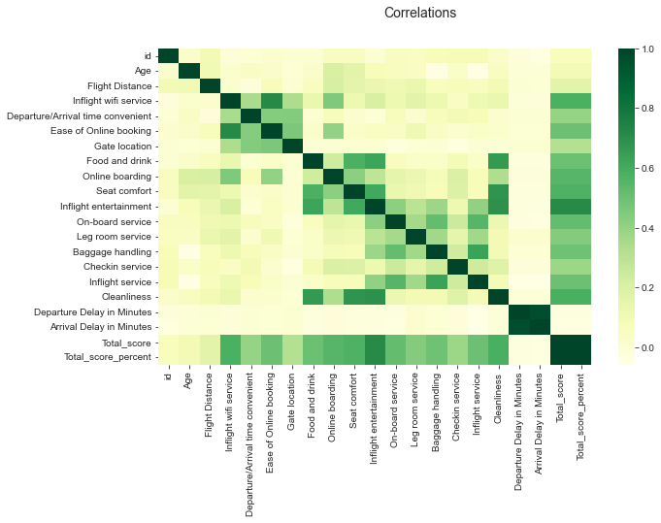
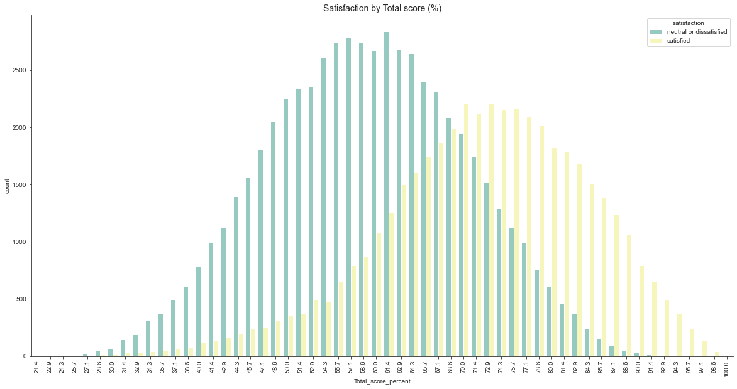
Exploration of the Data
Finally, we note that: - Satisfaction scores are normally distributed - Departure & Arrival Delay are highly correlated

Slide 26
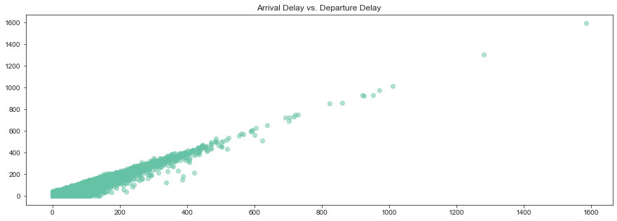
Imputing NA Values
Iterative Imputer was utilized on ‘Arrival Delay in Minutes’ with 130 missing values as it had a linear correlation with ‘Departure Delay in Minutes’

Slide 27
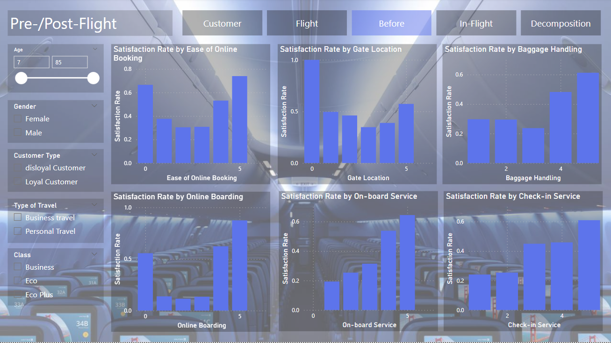
Imputing Satisfaction Scores
Satisfaction Scores are meant to be 1-5, but our dataset included many 0s
The dashboard made using after the first round of pre-processing revealed a high satisfaction rate amongst those with a satisfaction of 0, thus KNN imputer was utilized
Changing it to the median might have gotten us a 4 or a 3, which have lower rates of satisfaction in some cases

Slide 28
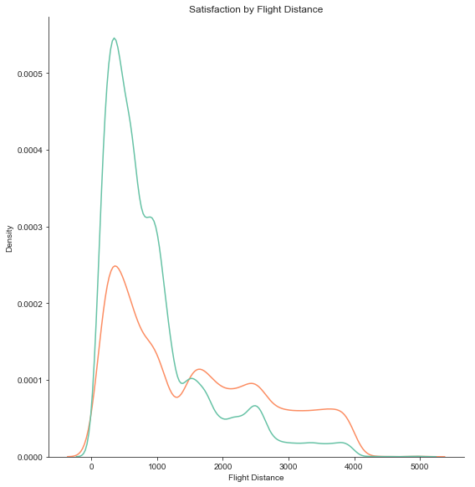
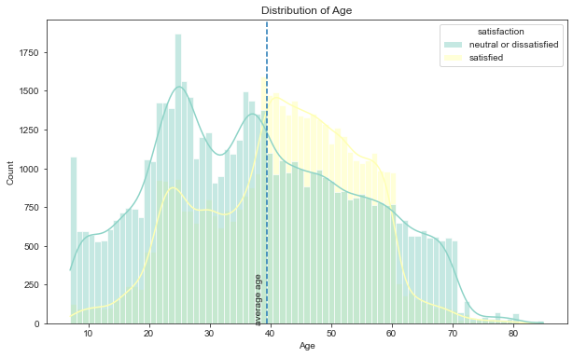
Removing Outliers & Normalization
Outliers in the training set were detected using an Isolation Forest with contamination = 0.01
Columns with a flight distance greater than 4,500 were removed
A log transformation was applied to ‘Flight Distance’ (see distribution on the left), ‘Departure Delay in Minutes’, and ‘Arrival Delay in Minutes’
Standard scaler was utilized for ‘Age’ (see distribution on the right)

Slide 29
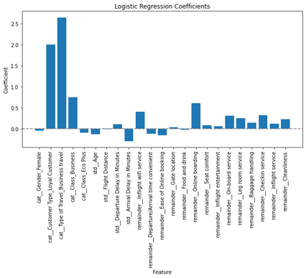
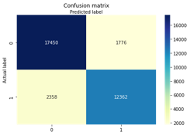
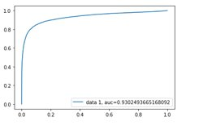
Classification – Logistic regression
87%
Precision
84%
Recall

Slide 30
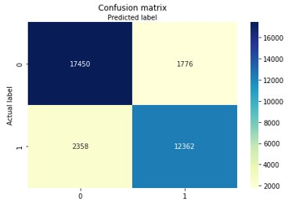
Classification - SVM
 | Precision | Recall | F1-Score | Support
Neutral or dissatisfied | 0.88 | 0.91 | 0.89 | 19226
Satisfied | 0.87 | 0.84 | 0.86 | 14720
Accuracy |  |  | 0.88 | 33946
Macro avg | 0.88 | 0.87 | 0.88 | 33946
Weighted avg | 0.88 | 0.88 | 0.88 | 33946
88%
Accuracy

Slide 31
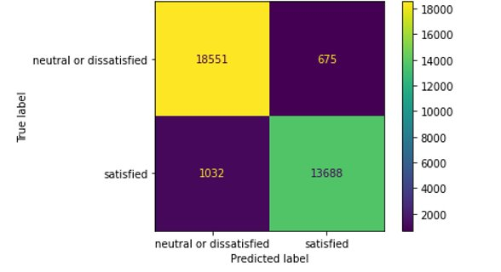
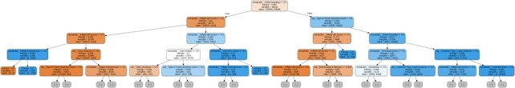
Classification – Decision trees ​
94.89%
15
94.94%
Accuracy
‘max_depth’
Accuracy
In train dataset
In test dataset
Part of the Decision tree generated

Slide 32
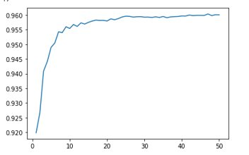
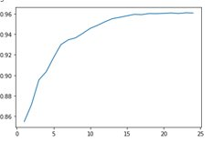
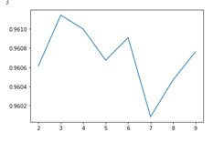
Classification – Random Forests
n_estimators vs Accuracy
Max_depth vs Accuracy
min_samples_split​ vs Accuracy​
The best classification score is 0.96​

Slide 33
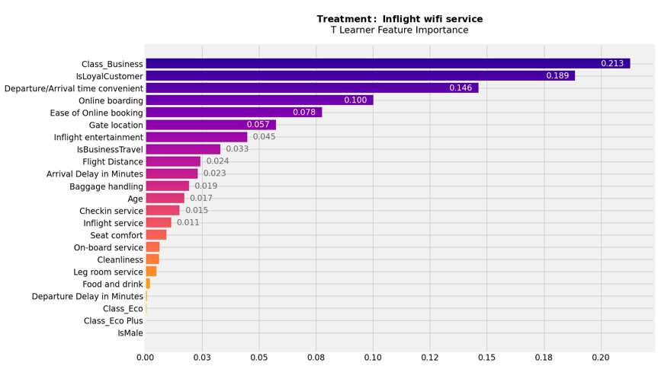
Preliminary Results
Treatment I: Inflight Wi-Fi service

Slide 34
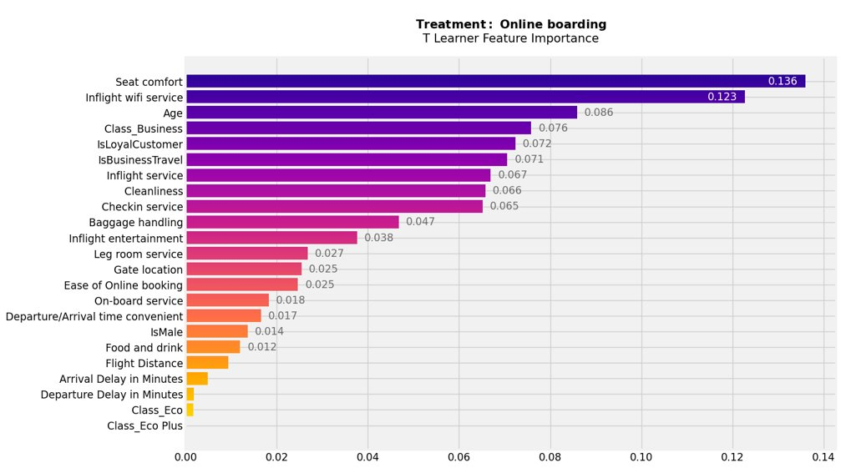
Preliminary Results
Treatment II: Online boarding

